Slide 1
Relaxation of chromosomes modeled as pinned polymer loop
Wenwen Huang
19.10.2015

Slide 2
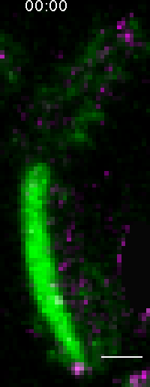
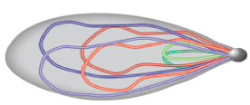
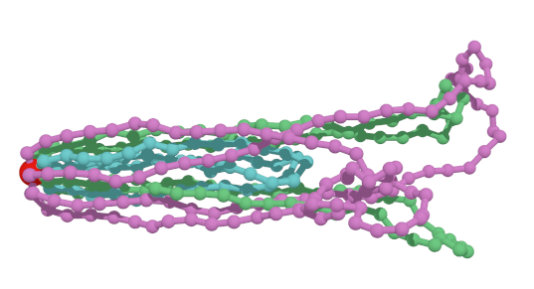
Nuclear Oscillation is Non-equilibrium
chromosome is modeled by pinned polymer loop

Slide 3
Results of Equilibrium statistics
a ratio between random noise and external force field

Slide 4
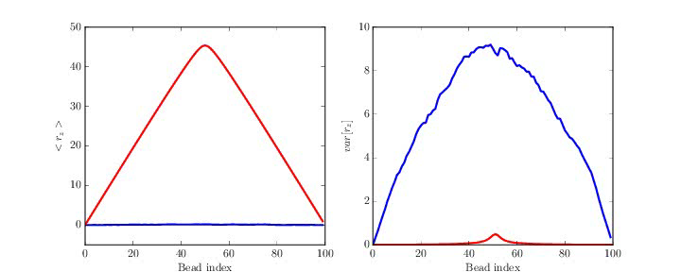
3D Brownian Dynamics Simulation (T = 1)

Slide 5
3D Brownian Dynamics Simulation (T = 1)

Slide 6
3D Brownian Dynamics Simulation (T = 1)

Slide 7
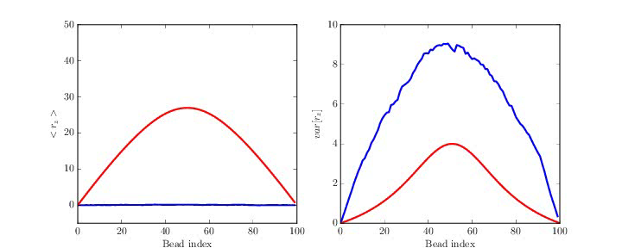
3D Brownian Dynamics Simulation (T = 10)

Slide 8
3D Brownian Dynamics Simulation (T = 10)

Slide 9
3D Brownian Dynamics Simulation (T = 10)

Slide 10
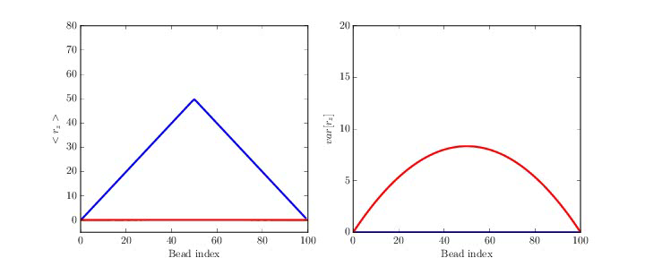
3D Brownian Dynamics Simulation (T = inf.)

Slide 11
3D Brownian Dynamics Simulation (T = inf.)

Slide 12
3D Brownian Dynamics Simulation (T = inf.)

Slide 13
Relaxation time for different T (3D)

Slide 14
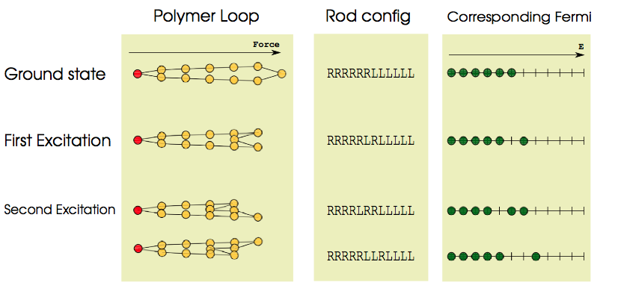
From polymer to particle (1D)

Slide 15
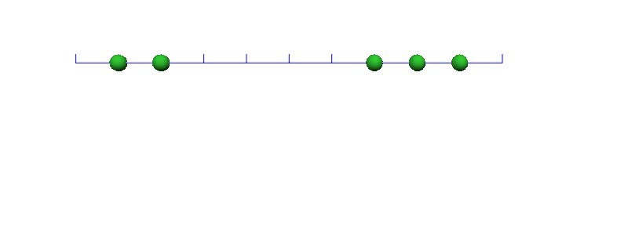
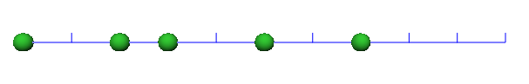
Kinetic Monte Carlo simulation
Probability jumping to right:
Probability jumping to left:

Slide 16

1D Kinetic Monte Carlo simulation (T = 1)

Slide 17
1D Kinetic Monte Carlo simulation (T = 1)

Slide 18
1D Kinetic Monte Carlo simulation (T = 1)

Slide 19
1D Kinetic Monte Carlo simulation (T = 10)

Slide 20
1D Kinetic Monte Carlo simulation (T = 10)

Slide 21
1D Kinetic Monte Carlo simulation (T = 10)

Slide 22
1D Kinetic Monte Carlo simulation (T = inf.)

Slide 23
1D Kinetic Monte Carlo simulation (T = inf.)

Slide 24
1D Kinetic Monte Carlo simulation (T = inf.)

Slide 25
Relaxation time for different T (1D)

Slide 26
Summary
Relaxation of chromosomes modeled by pinned polymer loop has a two different regime
the bead (chromosome segment) moves linearly along the external force field
beads are further equilibrate, characterized by a universal exponential decay depends only on effective T
Map the relaxation of pinned polymer to a particle single file diffusion looks promising.

Slide 27
All suggestions and comments
are greatly appreciated!
Thank you!

Slide 28
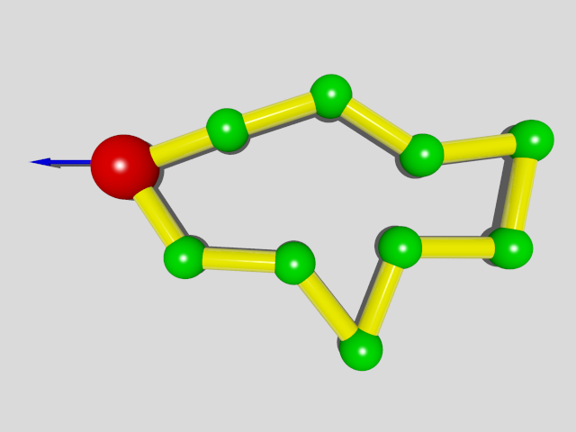
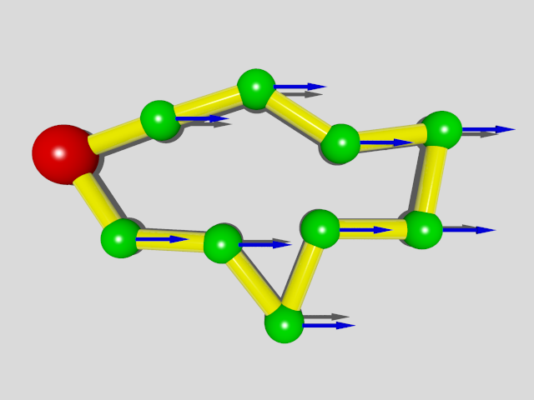
Theory for 1D model
Transfer to co-moving frame:
Constant driven force on SPB
Constant force field and pinned SPB
For 1D system:
Loop Constraint:

Slide 29
Theory for 1D model
Hamiltonian:
Equivalent to N/2 Fermions in N energy levels

Slide 30
Theory for 1D model
Partition function
By setting natural temperature unit
Fermi-Dirac distribution
Statistical Results

Slide 31
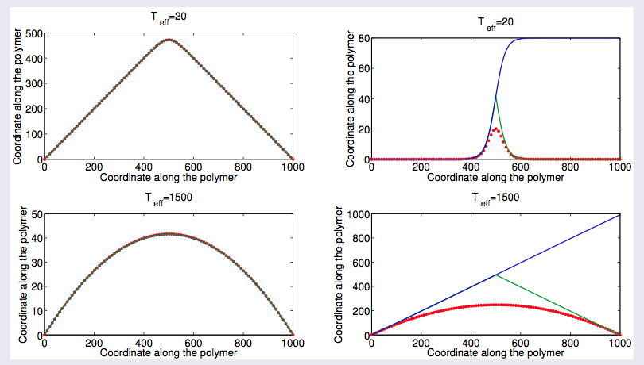
1D Theory

Slide 32
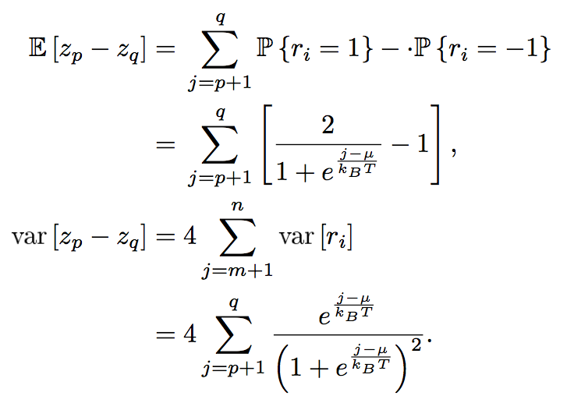
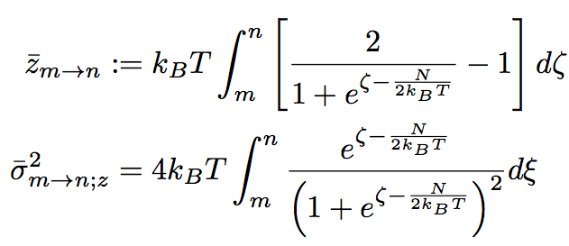
Brownian Bridge Approach
--- devise an effective stochastic process satisfies Z_{N}= Z₀
Step 1: construct effective process:
Z₀ = 0;
Z_{l} is almost surely continuous;
Z_{l} has independent increments;
Where the mean and the variance is determined by:

Slide 33
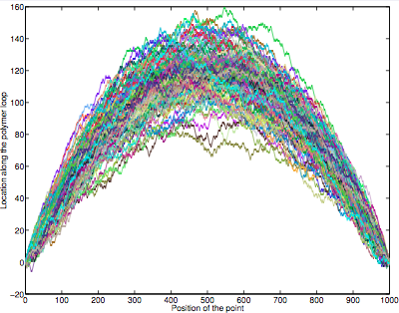
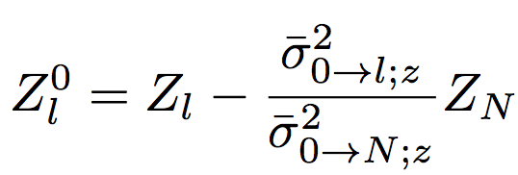
Brownian Bridge Approach
--- devise an effective stochastic process satisfies Z_{N}= Z₀
Step 2: introduce loop condition
Construct conditional process:
where

Slide 34
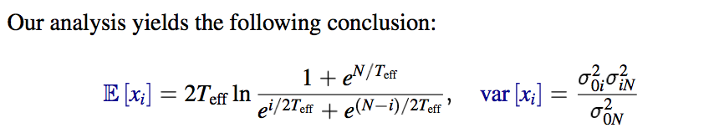
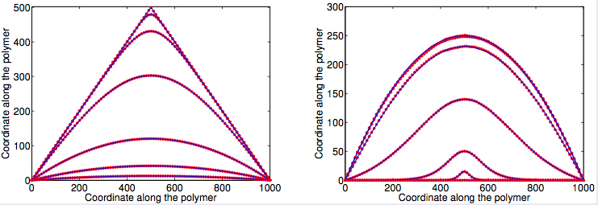
Numerical Verification of 1D model

Slide 35
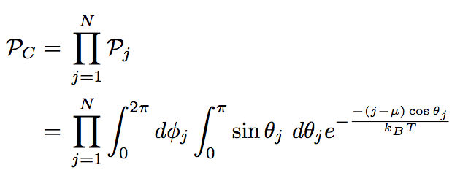
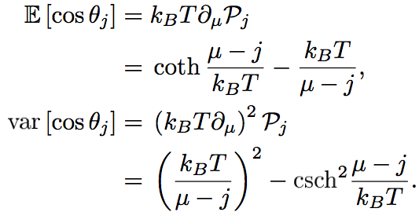
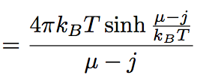
3D Continuous Model
Hamiltonian
Heisenberg model
Partition function

Slide 36
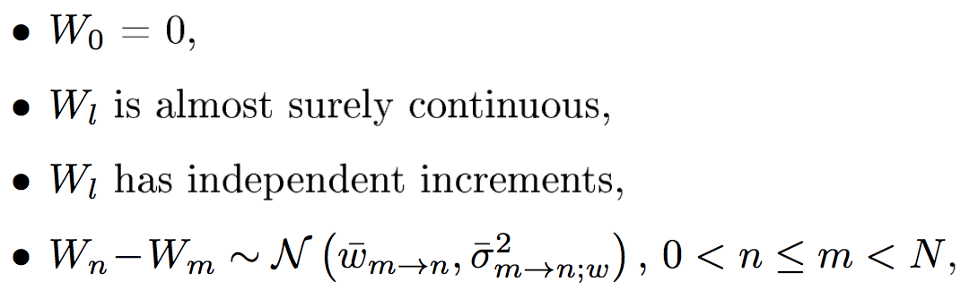
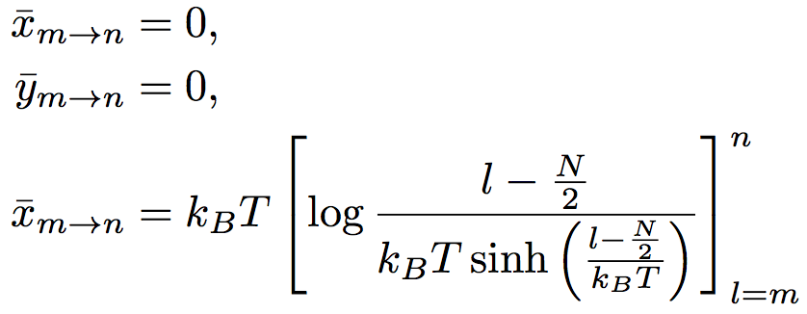
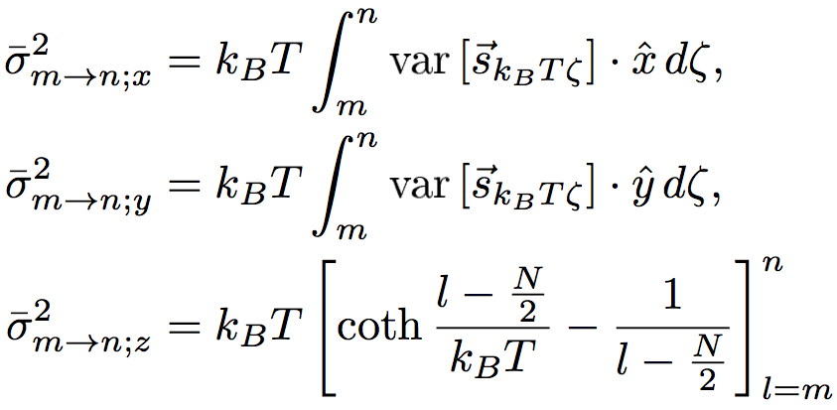
Adopt Brownian Bridge Approach
Define Effective 3D stochastic process:
Conditional effective process:

Slide 37
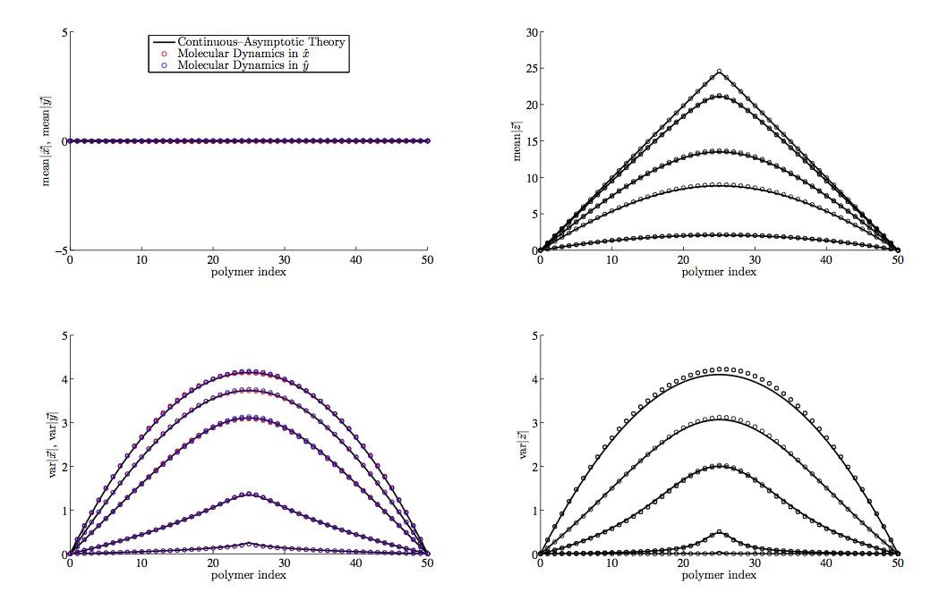
Numerical Verification of 3D model

Slide 38
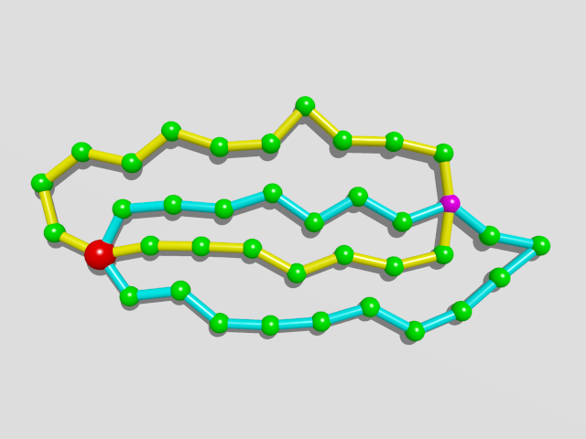
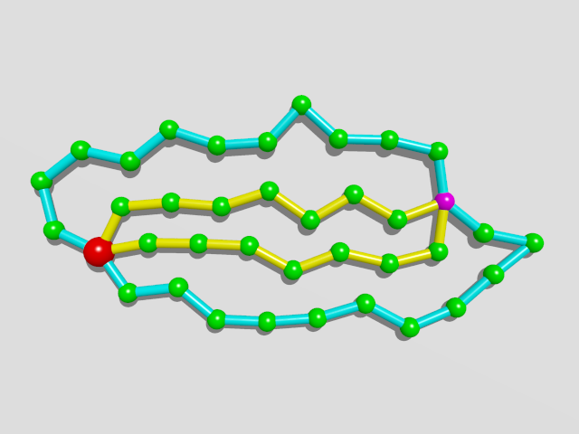
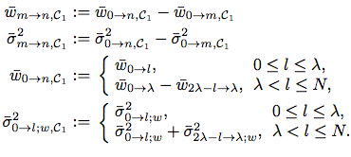
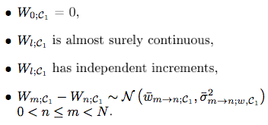
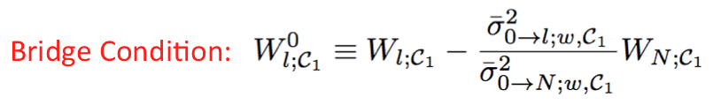
A Pair of Rings with Centromere
Re-label the loops
Brownian Bridge

Slide 39
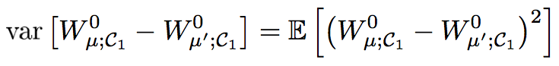
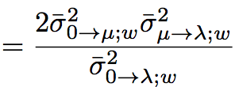
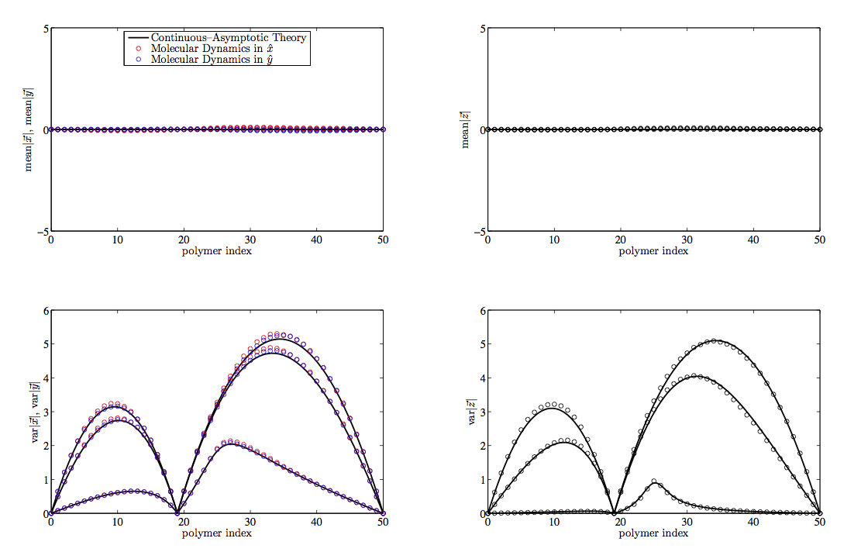
Numerical Verification
Theoretical Result

Slide 40
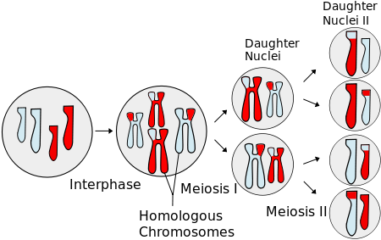
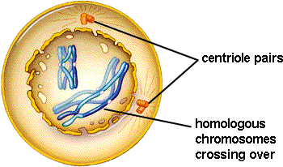
Meiosis
Prophase I
Chromosome movements
Pairing
Recombination

Slide 41
Brownian Dynamics:
Inertia-less assumption
is the index of bead
is hydrodynamic force
represents force generate from potential
is constraint force to keep the rod length
is brownian force
is external force

Slide 42
Brownian Dynamics:
Dynamical differential equation:

Slide 43
Numerical Scheme
Predictor-corrector algorithm:
Step 1: predict using known forces
Step 2: correct using constraint force
(*)
Step 3: substitute eq. (*) to constraint equations
Solve a set of nonlinear algebraic equations
Step 4: re-substitute to (*) obtain the final

Slide 44
Parameter Estimation
Length of Chromosomes in base pairs:
There are 3 pairs of chromosomes in prophase fission yeast
Chromosome I: 5.579.133 bp ~ 5,6Mbp
Chromosome II: 4.539.804 bp ~ 4,5Mbp
Chromosome III: 2.452.833 bp ~ 2,5Mbp
Compaction ratio of chromosomes: ~ 100bp/nm
Kuhn length(rod length): ~ 100nm
System size for 3 pairs of chromosomes: ~ 2000-3000
monomers in one ring : 200 ~ 600

Slide 45
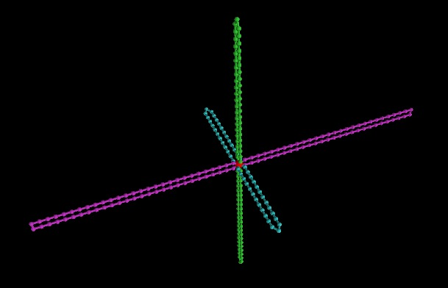
Initial configuration

Slide 46
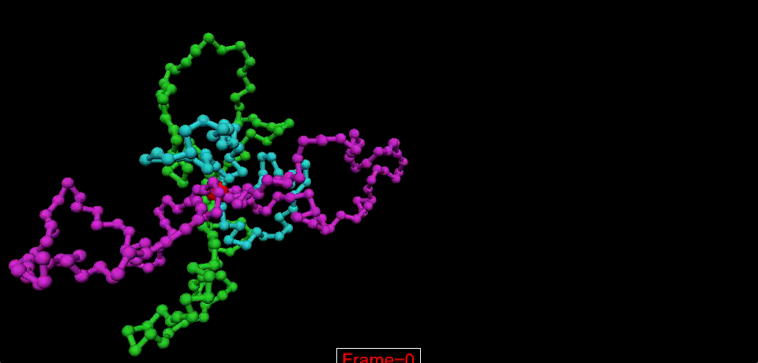
Animation Movie

Slide 47
Problem
Toy model with 100 beads
Real System
Solution:
Parallel computation

Slide 48
Ways to go
Use some kinds of sophisticated MD packages
Advantage:
easier to go, parallelize automatically
Disadvantage:
cannot control some details, e.g. random force
not so flexible
Write a parallel program
Totally under control but need more time on technique details
My Strategy
Doesn’t work
Write a parallel program
Try MD packages

Slide 49
List of MD packages
http://en.wikipedia.org/wiki/List_of_software_for_molecular_mechanics_modeling
Rules of selection
No commercial, should be free
Need GPU acceleration
Widely used
Selected packages:
Gromacs
LAMMPS
ESPResSo

Slide 50
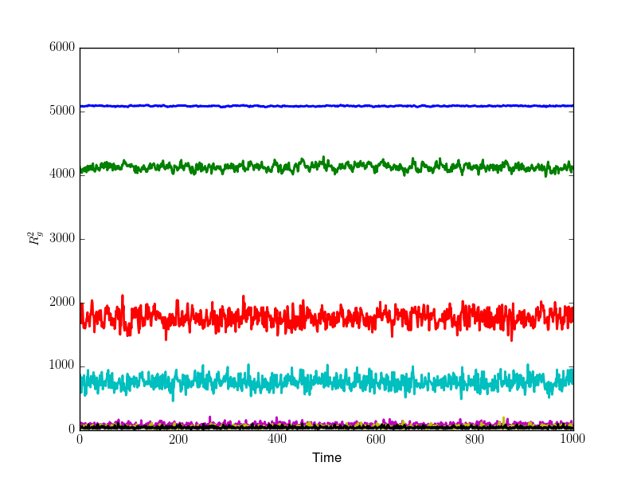
Results (N=500)

Slide 51
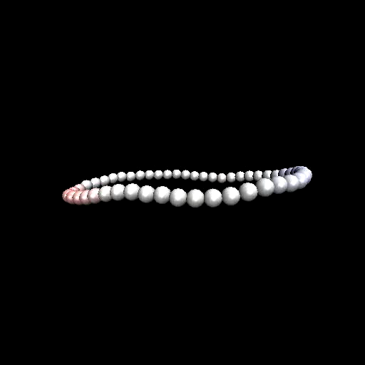
Tumbling dynamics
Philipp S. Lang etal. Phys. Rev. E 89, 022606 (2014)

Slide 52
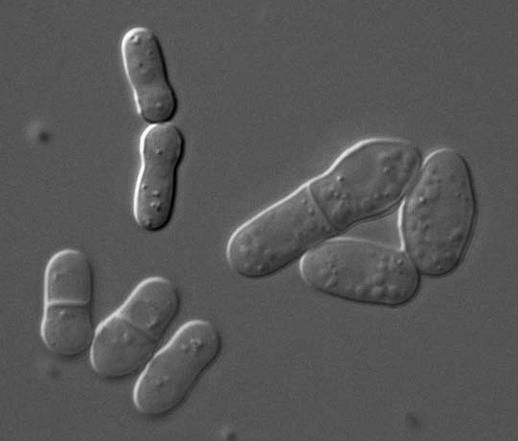

Fission Yeast( S. pombe)
Sketch of fission yeast
during cell division
Rhind N et al. Science. April 21, 2011

Slide 53
Chromosome Movement ( S. pombe)
3 pairs of chromosomes
Telomere bond to SPB
Oscillation is driven by SPB
In the mean time:
Homologous chromosomes
paring and recombination
Chikashige et al., Science 1994
Yamamoto et al, JCB 1999
Ding et al., DevCell 2004

Slide 54
Model chromosome by polymer loops
One Chromosome is represented by a polymer ring with the driven bead be the SPB(spindle pole body).
co-moving frame

